Slide 1
APB PROTOCOL
Name: Mark Amgad

Slide 2
Content
AMBA Bus Architecture.
APB Interface Diagram.
Operation Of APB.
BIN Description.
Verilog Design Code , Test bench and Do file.
Questa Sim Wave Form Simulation.
XILINX Vivado Elaborated Design Schematic.
XILINX Vivado Synthesized Design Schematic.
Report Timing Summary.
Tools.
Sources.

Slide 3
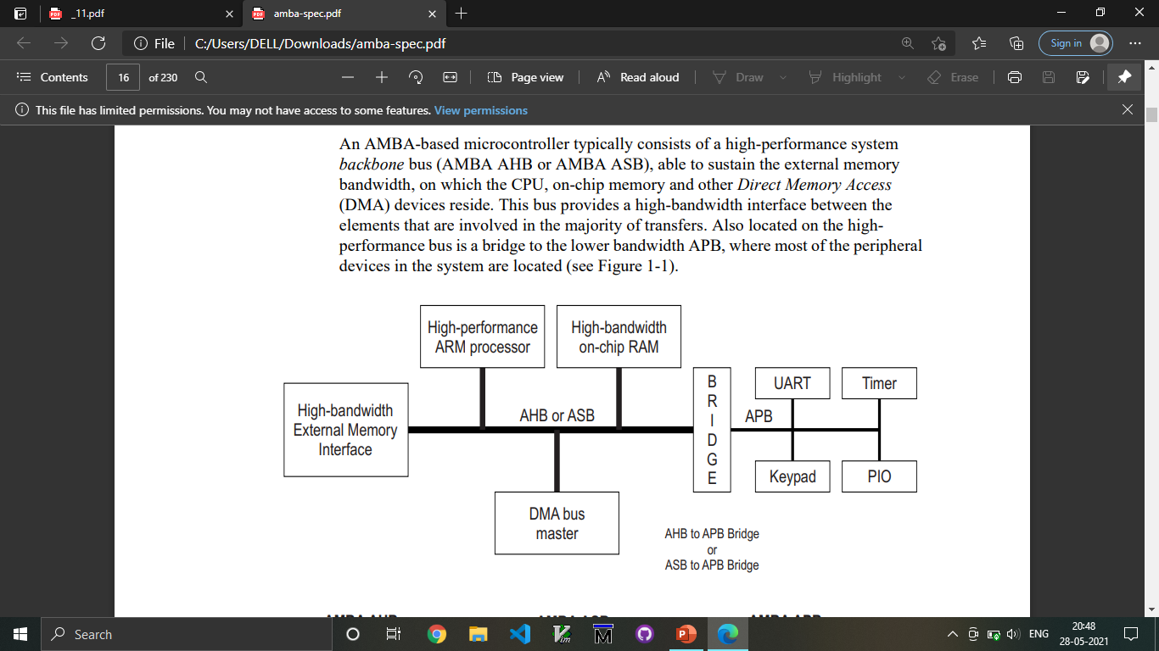
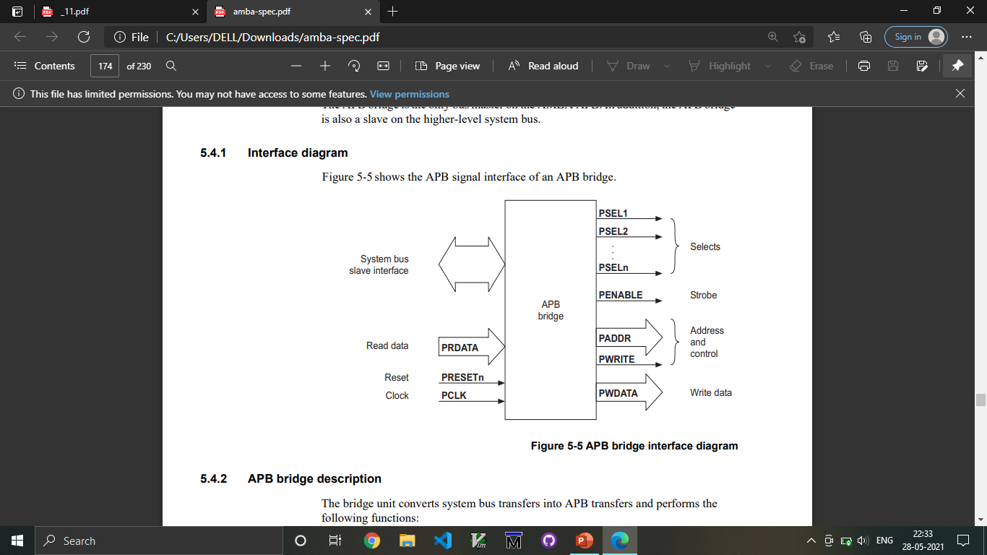
AMBA ARCHITECTURE

Slide 4
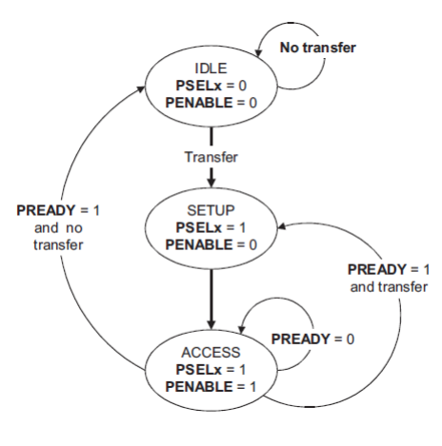
Operation of APB
IDLE
SETUP
ACCESS

Slide 5
PIN Description
SIGNAL | SOURCE | Description | WIDTH(Bit)
Transfer | System Bus | APB enable signal. If high APB is activated else APB is disabled | 1
PCLK | Clock Source | All APB functionality occurs at rising edge. | 1
PRESETn | System Bus | An active low signal. | 1
PADDR | APB bridge | The APB address bus can be up to 32 bits. | 32
PSEL | APB bridge | There is a PSEL for each slave. It’s an active high signal. | 1
PENABLE | APB bridge | It indicates the 2nd cycle of a data transfer. It’s an active high signal. | 1
PWRITE | APB bridge | Indicates the data transfer direction. PWRITE=1 indicates APB write access(Master to slave) PWRITE=0 indicates APB read access(Slave to master) | 1
PREADY | Slave Interface | This is an input from Slave. It is used to enter access state. | 1
PRDATA | Slave Interface | Read Data. The selected slave drives this bus during read operation | 32
PWDATA | Slave Interface | Write data. This bus is driven by the peripheral bus bridge unit during write cycles when PWRITE is high. | 32

Slide 6
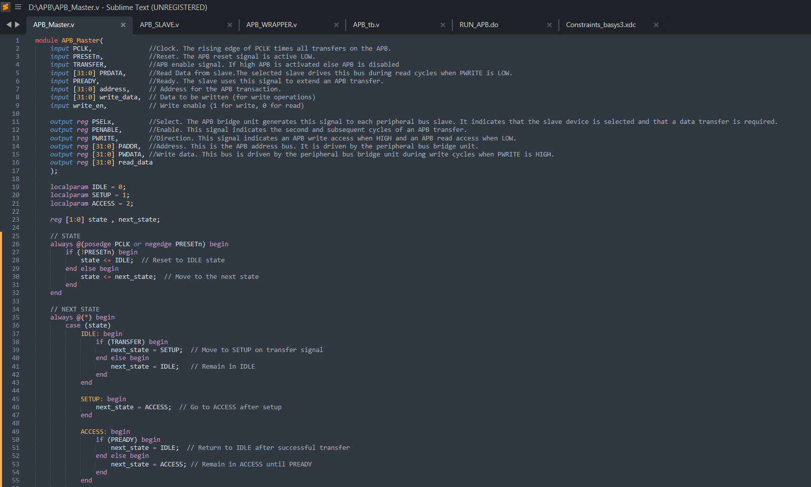
Verilog Design Code

Slide 7
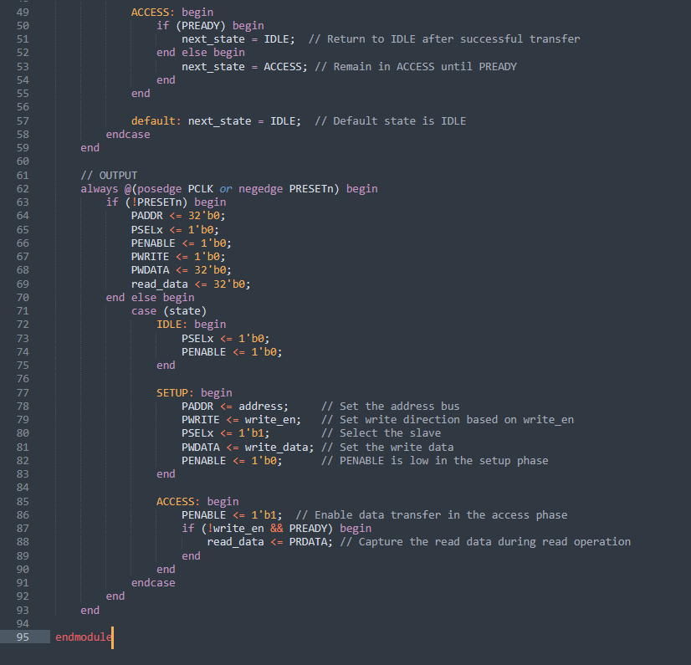
Verilog Design Code

Slide 8
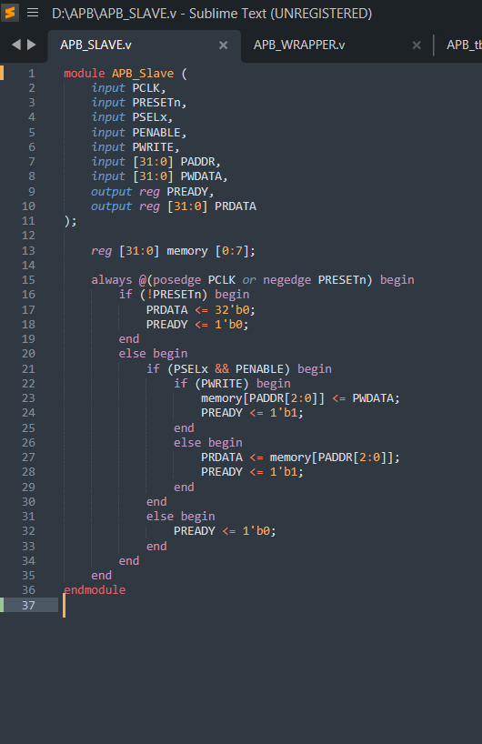
Verilog Design Code

Slide 9
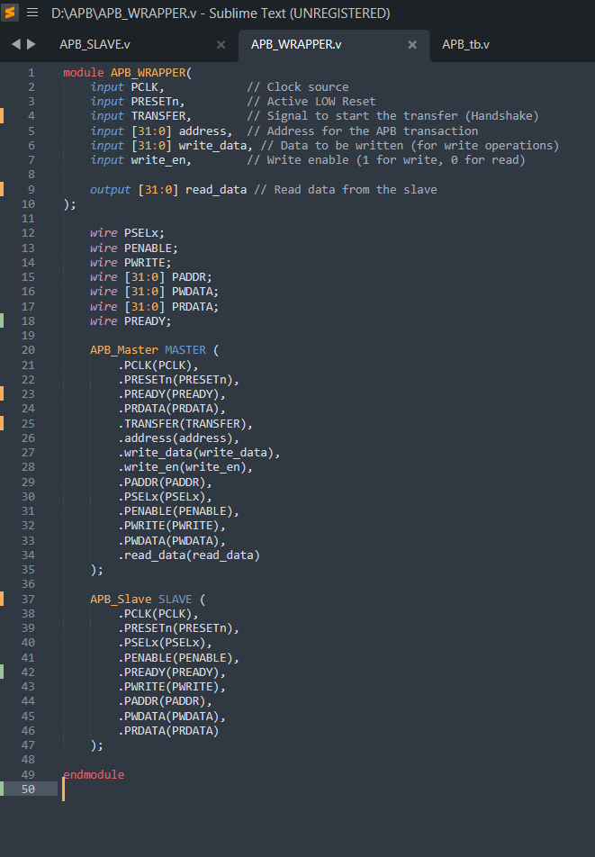
Verilog Design Code

Slide 10
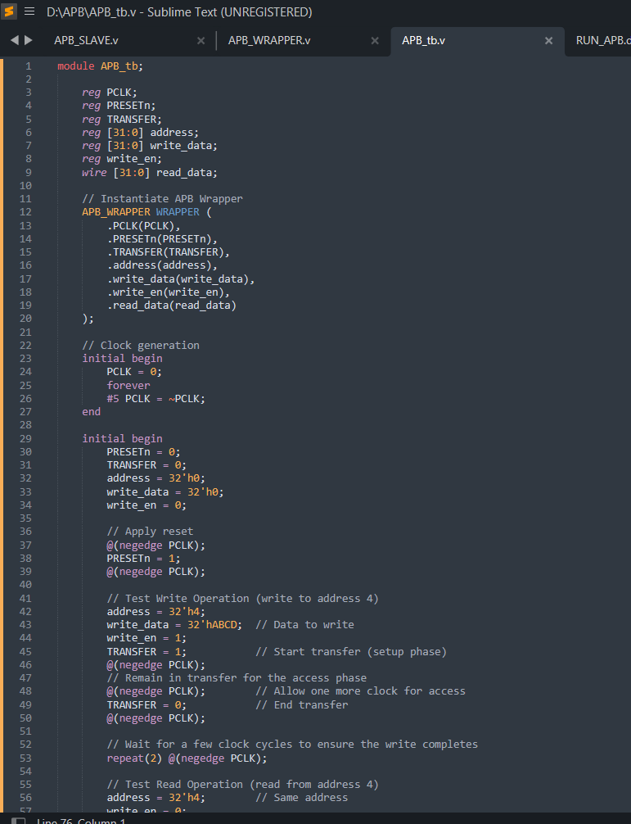
Test bench

Slide 11
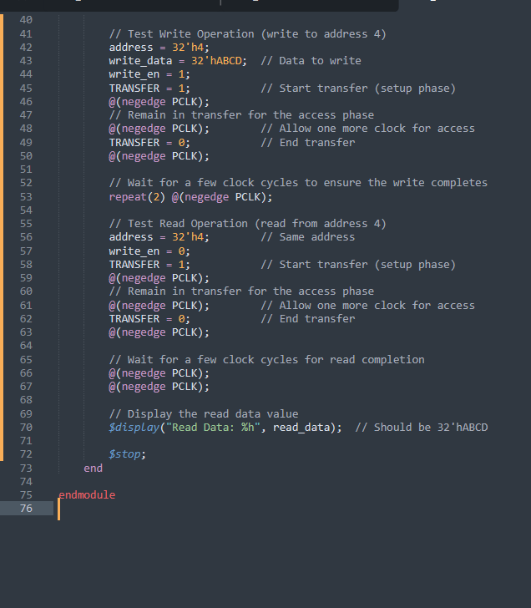
Test bench

Slide 12
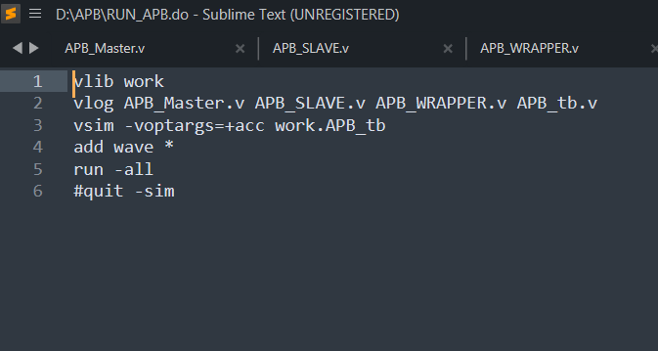
Do file

Slide 13
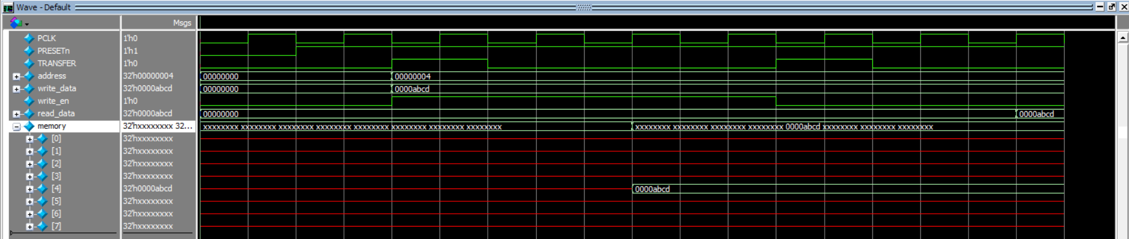
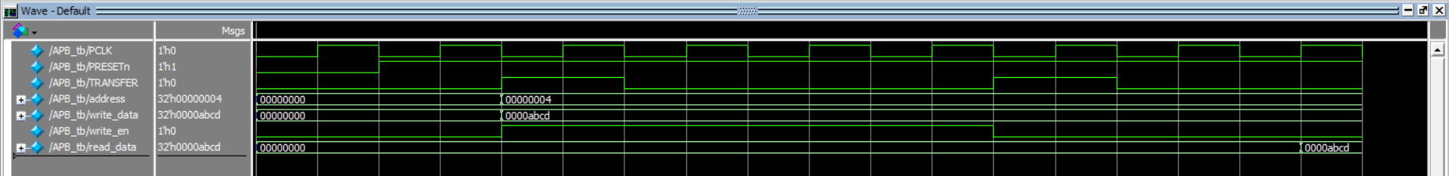
Wave Form

Slide 14
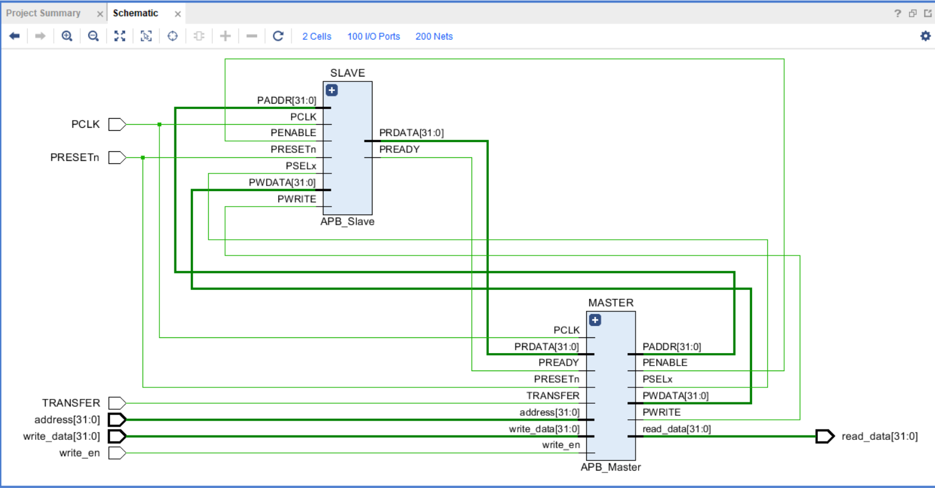
ELABORATED DESIGN

Slide 15
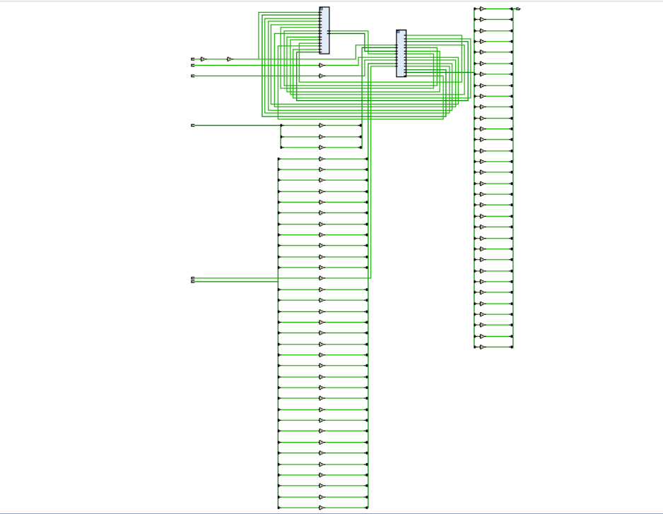
SYNTHESIZED DESIGN

Slide 16
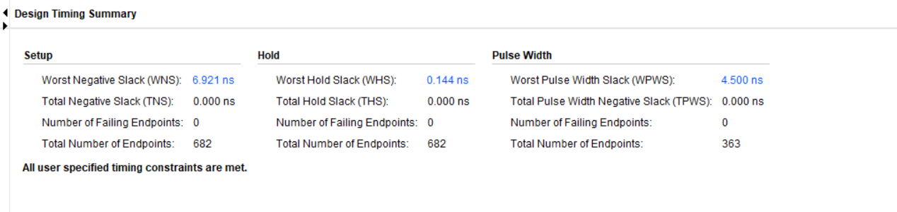
REPORT TIMING SUMMARY

Slide 17
Tools
Sublime
Questa Sim
Xilinx Vivado

Slide 18
Sources
AMBA® APBProtocol:
https://www.eecs.umich.edu/courses/eecs373/readings/IHI0024C_amba_apb_protocol_spec.pdf
https://documentation-service.arm.com/static/60d5b505677cf7536a55c245?token=

